Slide 1
Safeguarding Induction

Slide 2
Acknowledgement
The Diocese of Cairns acknowledges the lifelong trauma of abuse victims, survivors and their families; the past failure of the Catholic Church to protect, believe and respond justly
to children and adults at risk;
and the consequent breaches of community trust.
Notes:
To quote Pope Francis
“Families need to know that the Church is making every effort to protect their children.
They should also know that they have every right to turn to the Church with full confidence for it is a safe and secure home”

Slide 3
What is Safeguarding?
Safeguarding refers to the measures, practices and action taken to protect and promote the safety, human rights and wellbeing of individuals, which allow people to live free from abuse, harm and neglect.
(National Catholic Safeguarding Standards)

Slide 4
Through Safeguarding,
the Catholic Diocese of Cairns aims
to create an atmosphere of care and protection
in all parishes, ministries, services and agencies.

Slide 5
Background
The Royal Commission into Institutional Responses to Child Sexual Abuse was established in January 2013.
In December, 2017 the Commission presented its final report to the Governor-General detailing the findings.
Volume Six (6) of the Royal Commission’s final report outlined how child safeguarding standards would make organisations safer for children, and how regulatory oversight could be improved.
Notes:
During the five year enquiry the Commission had:
57 Hearings
1300 Witness Accounts
Heard 8000 Personal Stories

Slide 6
Background
Catholic Professional Standards Ltd (CPSL) was established by the Catholic Church leadership, after the Royal Commission. Scope included children and vulnerable adults.
Based on the recommendations of the Royal Commission, in 2019, CPSL developed 10 National Standards for the protection of children.
It also performed audit and compliance functions (assessing and reporting on compliance across entities) as well as capacity-building functions through education, research and support.

Slide 7
Background
Established in 2020 and incorporated key functions of CPSL.
Purpose: Promote a National Safeguarding/Professional Standards framework.
Has Responsibility for:
National Catholic Safeguarding Standards (NCSS)
Australian Catholic Centre for Professional Standards
Australian Catholic Ministries Register (ACMR)
National Response Protocol (Responding to child abuse concerns/ allegations)

Slide 8
Latest
The first phase in developing the National Catholic Safeguarding Standards (NCSS) focused on safeguarding practices to protect children.
The second phase incorporates care and protection of adults, with a focus on adults at risk, in keeping with the recommendations of the Royal Commission. The second edition of the NCSS was published end of 2022.
Notes:
Adapted from National Catholic Safeguarding Standards Edition 2 (2022) Compendium; Supplementary Material to assist reading the NCSS Ed. 2; pg 7
Extensive consultation occurred about the use of the term 'adults at risk' rather than 'vulnerable adults’.
The National Reference Group, which has guided the development of the Standards, strongly recommended this terminology as being contemporary practice for several reasons:
It shifts the focus from defining a victim, to identifying the circumstances that may place an adult at risk.
It captures the key risk factor of adult abuse, being abuse of power by someone in authority.
'Adults at risk' is the term used and approach taken by Australian regulatory bodies, including the Australian Charities and Not-for-profits Commission, and international organisations including Catholic Safeguarding Standards Agency (CSSA)- the UK and Wales equivalent of ACSL.
From a Canonical perspective, an 'adult at risk' is one who is 'at risk' and incurs harm due to breaches of Canon 1395 §3 the "force, threats or abuse of authority". Therefore, for the context of safeguarding and needs of the Catholic Church in Australia, the term 'adult at risk' is an appropriate term which finds no conflict with Canon law.
There is no longer a Canonical definition for the terms 'vulnerable person' or 'vulnerable adult'. Through the consultative process for the new Book VI of the Code of Canon Law, these terms were avoided due to the new law being applied throughout the world and these phrases are understood in a variety of ways depending on local circumstances.
The revised Book VI of the Code speaks of 'minors' and those equivalent ("who habitually have an imperfect use of reason ..."), as well as the abuse of ecclesiastical power (canon 1378 §1). Canon 1378 on the abuse of ecclesiastical power refers not only to clerics and religious, but also lay personnel (e.g. a diocesan finance administrator).

Slide 9
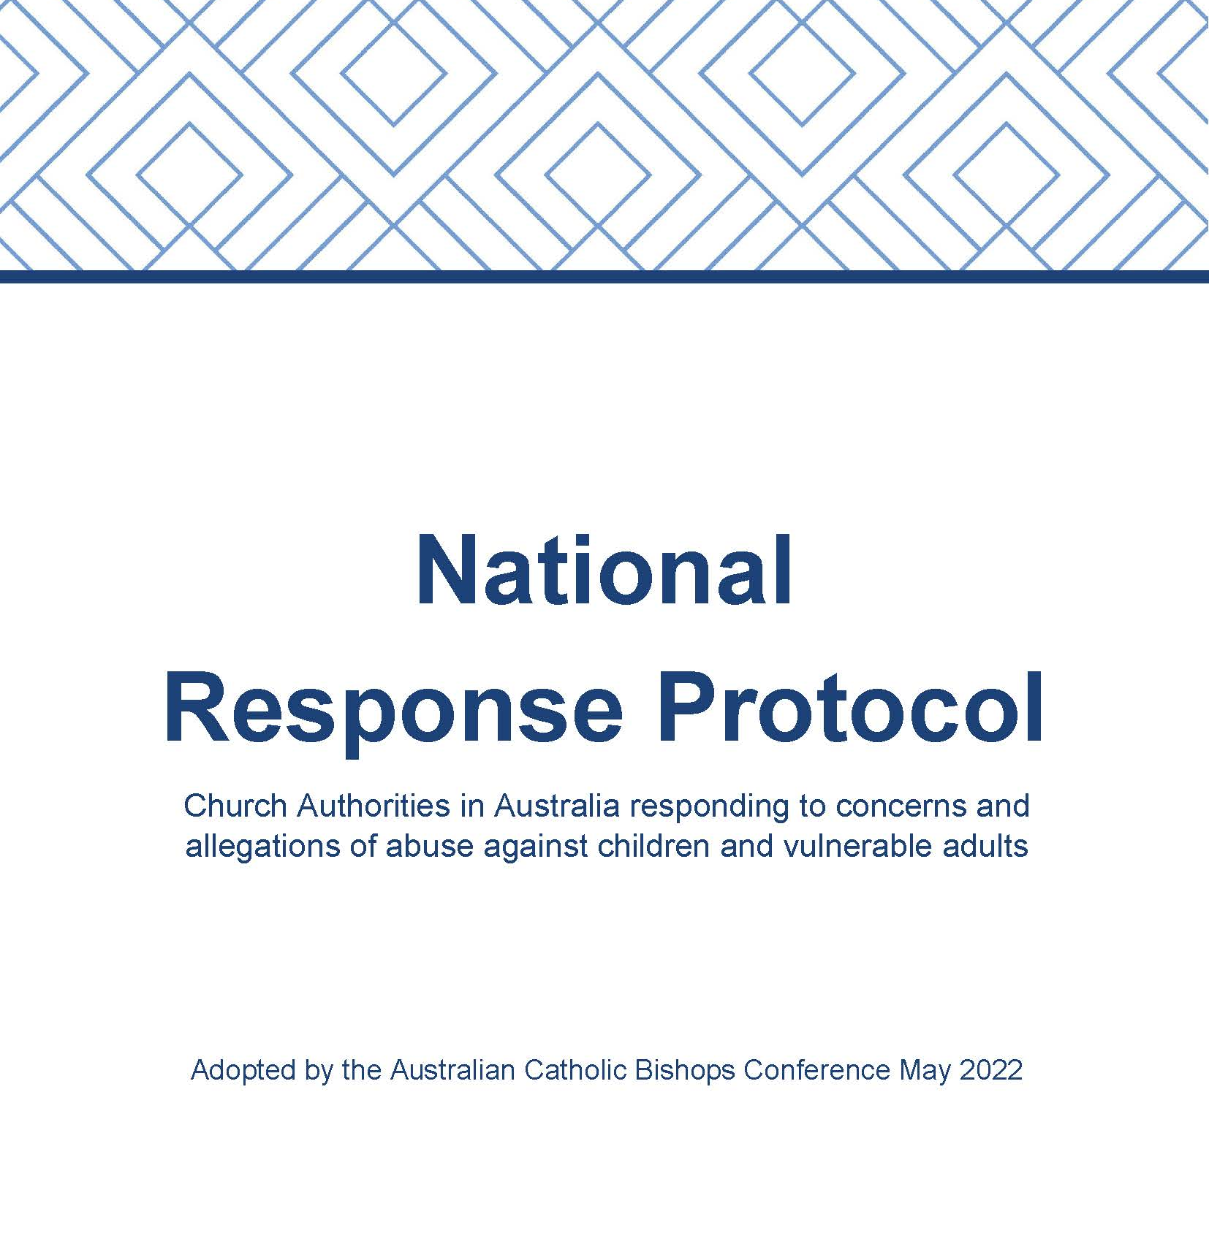
Notes:
In response to Recommendations 7.7 and 16.37 of the Royal Commission, the Australian Catholic Bishop’s Conference and Catholic Religious Australia commissioned a review of the previous relevant protocols, namely Towards Healing and the Melbourne Response.
The National Response Protocol came into effect in May 2022.

Slide 10
The National Response Protocol
Process:
Receive and acknowledge the concern/allegation
Report to external and internal authorities
Determine a course of action
Investigate
Assess and make a determination
Notes:
The Protocol is part of a comprehensive approach to Safeguarding across catholic church authorities in Australia supporting the 10 National Catholic Safeguarding Standards.
The Protocol does not cover forms of professional misconduct or unprofessional behavior that fall outside of the scope of child abuse.

Slide 11
Rationale for Safeguarding
The Catholic Diocese of Cairns has zero tolerance for abuse
of children or adults-at-risk.
It is an expectation within the Diocese that everyone will strive to
ensure the protection and safeguarding of any and all vulnerable persons.
The Safeguarding policy applies to all Church personnel - clergy, religious, pastoral associates, employed staff and volunteers and informs and directs all child protection procedures within the Diocese of Cairns.
This encompasses the requirement to abide by all protocols, guidelines and codes of conduct in place.
SAFEGUARDING IS EVERYONE’S RESPONSIBILITY

Slide 12
Safeguarding Principles
Safeguarding is everyone’s responsibility.
Treat everyone with dignity and respect.
Prioritise the protection and best interests of children and adults-at-risk.
Provide safe physical and online environments.
Actively identify and manage safeguarding and abuse risks.
Monitor compliance with Safeguarding standards and Policy.
Respond promptly to all abuse concerns, suspicions, incidents and reports.
Comply with all Statutory reporting obligations.

Slide 13
‘Two Adults’ Rule
Wherever practicable at least two adults should be present at all times during any parish/agency program, event or ministry involving children or adults-at-risk.
Why have this rule?
Significantly reduces the risk of an incident of abuse – (constantly in sight of another adult);
Protects the ministering adults against false allegations;
Reduces the possibility of a claim of negligence;
Increases the likelihood that parents and adults will volunteer to lead as they know they will have help on a regular basis;
Provides help if there is an accident or emergency.
Notes:
A well-regarded practice in activities involving children or adults-at-risk is the application of the "Two Adults" Rule. This means that wherever practicable at least two adults should be present at all times during any parish/agency program, event or ministry involving children or adults-at-risk.
In essence, this practice serves to keep not only children and the vulnerable safe but also those serving them.

Slide 14
Duty of Care
A duty of care is a common law obligation.
It simply means having the responsibility to take reasonable action to prevent foreseeable risks of injury or harm.
The Diocese can be liable when its personnel breach a duty of care.
All personnel, including volunteers, need to consider their duty of care when working for the Diocese.

Slide 15
UN Convention on the Rights of the Child
These rights apply to every child regardless of race, religion, gender or abilities. Every child has the right to:
PROTECTION FROM ABUSE & NEGLECT
PROTECTION FROM SEXUAL ABUSE
PRIVACY
HOLD PERSONAL BELIEFS
BEST INTERESTS PROMOTED
PRACTICE THEIR OWN RELIGION
Notes:
Some of the most important rights afforded to children under the United Nations Convention include:
The right to protection from abuse and neglect.
The right to protection from sexual abuse.
The right to privacy.
To have their best interests promoted within organisations.
To hold personal beliefs.
To be consulted on important decisions that affect them.
To practice their own religion.
Special care and support for the disabled.

Slide 16
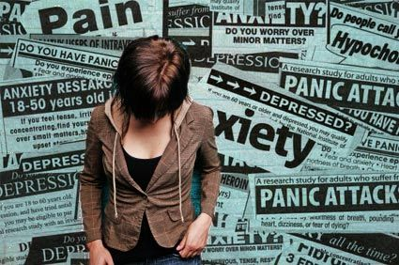
Understanding Abuse
Abuse is the mistreatment of a person which causes them harm
Abuse may be one act or a series of acts.
Notes:
The Cairns diocese defines ‘abuse’ as the mistreatment of a person which causes that person harm.
Types of abuse include:
sexual abuse
physical abuse
psychological/emotional abuse
spiritual abuse
neglect
exploitation
It is important to note that ‘abuse’ may be perpetrated in one act or a series of acts. That is, there does not need to be multiple/repeated acts for abuse to have occurred.

Slide 17
Abuse Perpetrators
No typical profile or defining features
Can be male/female, adult/child
Most abuse is perpetrated by someone close to the victim
Person who has influence or authority over the victim
Will have most access, close contact, control over the victim
Notes:
Ex Commissioner Robert Fitzgerald speaking about abuse perpetrators:
“There are no fewer people now who have a predisposition to abuse children than there were 40 or 50 years ago.
Humankind and men have not changed. Can’t predict who they will be and you can’t change them………..
What we can do is set up an environment in which the risks are much less, early detection is much greater
and children are empowered to be able to resist more than they were.”

Slide 18
Abuse Risk Factors
Limited awareness/understanding of abuse
Complacent Safeguarding practices
Tendency to downplay abuse risks and incidents
Prioritises organization’s reputation when incidents occur
Fostering secrecy
Organisational
Characteristics of an organisation that make abuse more likely.

Slide 19
Abuse Risk Factors
Involvement of unsafe, unsuitable, high risk individuals in an activity.
Using unsuitable location or venue
Insufficient supervision
Activities involving 1:1 or private interactions
Unauthorised or unsupervised transport
Situational
Opportunities for perpetrators to interact and be alone with potential victims.

Slide 20
Abuse Risk Factors
Children and young people
Age and limited life experience.
High dependency on adults
Inadequate parenting/family violence
Poor understanding of sexual behavior/personal safety
Low self esteem
Adults
Advanced age
Financial hardship
Substance dependency
Suffering grief/loss
Experiencing social isolation
A disability
Cognitive impairment e.g. Dementia
Relationship problems/breakdown
Naïve/gullible
Vulnerability
Personal characteristics or circumstances that make an individual more susceptible to abuse.
Notes:
Abuse Risk Factors
Presence of one risk factor does not mean that abuse will occur. However, children with a number of risk factors are at increased risk of abuse.
Any adult may become vulnerable at any time in their life due to many different circumstances however those with high care and support needs are generally considered to be at greater risk.
While it is recognised that people with a disability have their own strengths and abilities they can be one of the most vulnerable in the community.

Slide 21
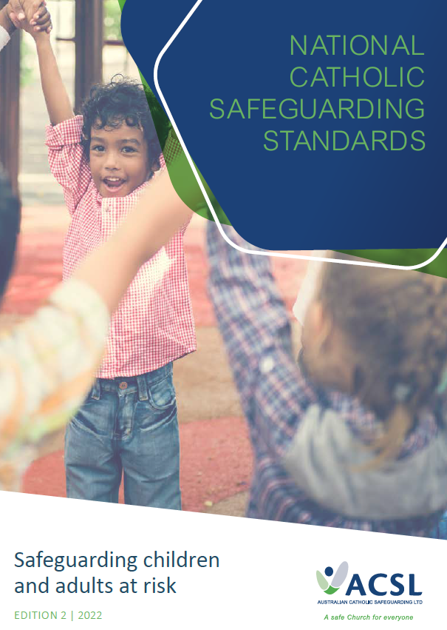
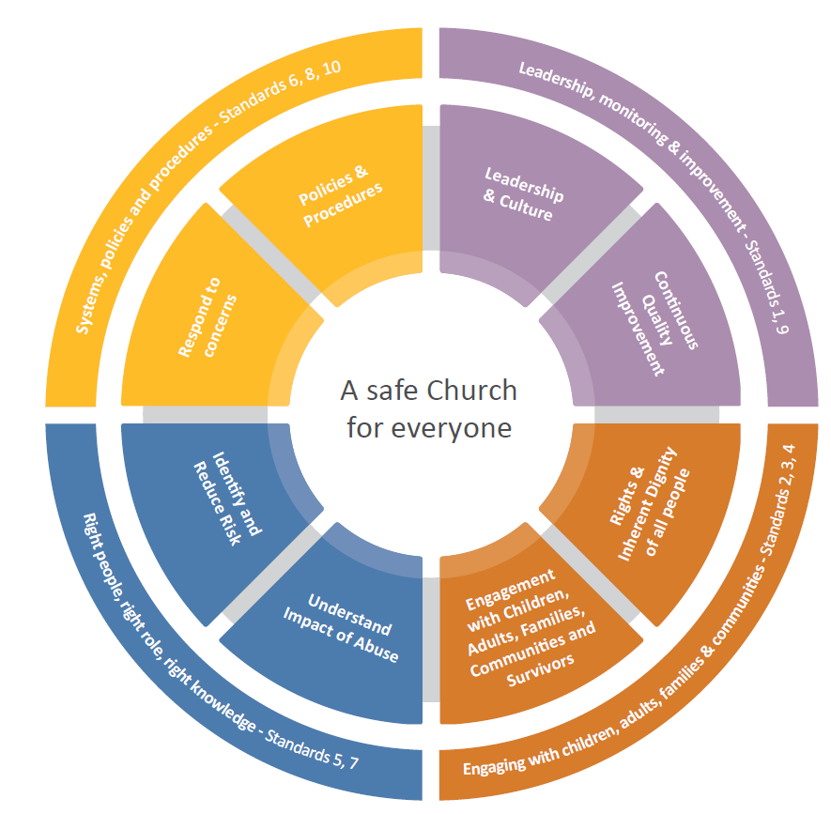

Slide 22
Australian Catholic Safeguarding Ltd
STANDARD ONE
Committed leadership, governance and culture
The leadership and governance arrangements of Church entities promote an inclusive, welcoming environment for children and adults; and provide the foundation for transparent, accountable and risk-based approaches to ensure safety.
Safeguarding Training Session
Notes:
The Church entity publicly commits to child safeguarding, acknowledges a shared responsibility at all levels, has code of conduct, risk management strategies to mitigate risks to children, and we as a church apply these standards to all ministries and activities of the church
Church personnel feel empowered to have a say in, and influence decisions about child safeguarding.
The Diocese of Cairns appoints a Safeguarding Committee at the highest level of leadership to oversee the effective ongoing implementation of child safeguarding practices, including the Child Safeguarding Policy and related procedures and practices.

Slide 23
Australian Catholic Safeguarding Ltd
STANDARD TWO
Children and adults are safe, informed and participate
Children and adults are informed about their rights, and are given the opportunity to participate in decisions which affect them and their views are taken seriously.
Safeguarding Training Session
Notes:
Children can express their views and given opportunities to participate in decisions that affect their lives, peer support is encouraged so that children feel safe and less isolated, Church personnel are attuned with signs of harm and facilitate child-friendly ways to communicate and raise their concerns.

Slide 24
Australian Catholic Safeguarding Ltd
STANDARD THREE
Partnering with families, carers and communities
Families, carers and communities are informed involved in promoting the safeguarding of children and adults.
Safeguarding Training Session
Notes:
The Church entity supports and encourages families and carers to take an active role in monitoring children’s safety when participating in Church activities. The Church entity promotes open dialogue and provides a range of ways for families, carers and communities to contribute to discussions about its child safety approach.

Slide 25
Australian Catholic Safeguarding Ltd
STANDARD FOUR
Equity is promoted and diversity is respected
Equity is upheld and diversity needs are respected in policy and practice
Safeguarding Training Session
Notes:
The Church entity’s Children and Adults Safeguarding Policy documents its approach to understanding and incorporating feedback from children with diverse backgrounds, circumstances and vulnerabilities.
The entity pays particular attention to the needs of adults at increased risk of discrimination, exploitation and all forms of abuse. These may include:
Individuals who are elderly, suffer from an illness, have a cognitive impairment or diminished capacity, are unable to care or protect themselves
From culturally and linguistically diverse backgrounds
Adults of diverse sexuality and gender

Slide 26
Culturally Safe Environment
Positive connection to culture is a protective factor – it promotes self-esteem, emotional strength and resilience (National Catholic Safeguarding Standards).
Cultural Safety Practices
Recognising and honouring other cultures e.g. acknowledging traditional owners of country
Holding a dedicated mass for particular groups (ATSI, Syro Malabar, Filipino)
Accommodating language and communication needs e.g. information in various languages/formats

Slide 27
Australian Catholic Safeguarding Ltd
STANDARD FIVE
Robust human resource management
Church personnel & people working with children and adults are suitable and supported to reflect safeguarding values in practice.
Safeguarding Training Session
Notes:
It is important that Recruitment practices, including advertising, screening and selection of Church personnel, emphasise child safeguarding, all personnel receive appropriate inductions and are aware of child safeguarding responsibilities including reporting obligations. The Church entity has a system for monitoring Working with Children Checks (Blue Cards)

Slide 28
Australian Catholic Safeguarding Ltd
STANDARD SIX
Effective complaints management
Processes for raising concerns and complaints are responsive, understood, accessible and used by children, adults, families, carers, communities and Church personnel.
Safeguarding Training Session
Notes:
The Church entity has a child-focused complaint-handling system that is understood by children, families, carers and Church personnel.
Complaints are taken seriously, responded to promptly and thoroughly and meet all reporting, privacy, employment and canon law obligations.
The Church Authority also ensures that mechanisms are in place to support respondents who may be facing allegations.

Slide 29
Australian Catholic Safeguarding Ltd
STANDARD SEVEN
Ongoing education and training
Personnel are equipped with knowledge, skills and awareness to keep children and adults safe through information, ongoing education and training.
Safeguarding Training Session
Notes:
Church personnel receive an induction on the Church entity’s Child Safeguarding policies and practices.
Church personnel receive training on the nature and indicators of child abuse and Church personnel receive training to enable them to respond effectively to issues of child safety and maintain a child safe culture.

Slide 30
Australian Catholic Safeguarding Ltd
STANDARD EIGHT
Safe physical and online environments
Physical and online environments promote safety and contain appropriate safeguards to minimise the opportunity for children and adults to be harmed.
Safeguarding Training Session
Notes:
Both the physical and online environments must be appropriate to minimise the opportunity for children and adults to be harmed.
Standard 8 also requires that the entity has conducted sufficient due diligence on all Third Parties who use the entity’s facilities e.g. Syro Malabar Eparchy
Strategies for mitigating online risks will be discussed next..

Slide 31
Online Risks – 3 Cs
Content: exposure to illegal, offensive
or harmful material
Contact: being subjected to abusive interactions online
(bullying, grooming)
Conduct: online behavior that increases likelihood of abuse
e.g. accepting unfamiliar online friends

Slide 32
Australian Catholic Safeguarding Ltd
STANDARD NINE
Continuous improvement
Entities regularly review and improve implementation of their systems for keeping children and adults safe
Safeguarding Training Session
Notes:
9.1 The entity’s safeguarding practices for the protection of children and adults at risk are regularly reviewed.
9.2 Concerns and complaints are analysed to identify causes and systematic failures in safeguarding practices.
9.3 The Church Authority reports on the findings of its safeguarding reviews.

Slide 33
Australian Catholic Safeguarding Ltd
STANDARD TEN
Policies and procedures support the safety of
children and adults
Policies and procedures document how the entity is safe.
Safeguarding Training Session
Notes:
Church personnel are made aware of, have read, understand and undertake to follow the Church entity’s policies and procedures; receive adequate training and education regarding the policies and procedures and how to implement them; and know who to approach with concerns or questions.

Slide 34
Policy Statement
The Diocesan Safeguarding policy applies to all diocesan activities, ministries, services and agencies. It acknowledges that:
‘Children, young people and vulnerable adults are a gift from God with an intrinsic right to dignity of life, respect and protection from harm.’
Notes:
To quote Pope Francis
“Families need to know that the Church is making every effort to protect their children.
They should also know that they have every right to turn to the Church with full confidence for it is a safe and secure home”

Slide 35
Codes of Conduct
All Church personnel are subject to a code of conduct.
Codes of conduct set expected behaviour standards.
Lay workers - Integrity in Service of the Church
Clergy/Religious - Integrity in Ministry
Notes:
The Diocesan Safeguarding Policy also includes a Code of Ethical Behaviour. The principles contained within the Code of Ethical Behaviour are:
Committing to justice and equity
Respect for the dignity and rights of others
Maintaining safe and supportive relationships
Responding with integrity to the poor, alienated or marginalized
Striving for excellence in work
Maintaining appropriate professional boundaries

Slide 36
Making an Abuse Disclosure
Direct disclosure
Telling someone exactly what happened
Indirect disclosure
Ambiguous/vague comments to alert
Giving some detail but not the full version
In writing (diary, texts, social media)
Drawings (particularly very young children)

Slide 37
Barriers to Disclosure
Unsure how to share
Not confident disclosure will be taken seriously
Fear of consequences
May feel conflicted or embarrassed
When children do speak out, it is often many years after the abuse has taken place

Slide 38
Managing disclosures – 3 Rs
Respond
Record
Refer
Notes:
The following is recommended by the Diocese in managing disclosures
Respond
Be open to hearing the disclosure. Don’t ignore, avoid or divert the person.
Find a confidential and safe place to hear the disclosure.
Listen – really listen! Allow the person to tell their story without interruption.
Remain calm even if the person becomes upset or angry. Acknowledge their feelings and emotions.
Express your understanding and acceptance of their experience.
Don’t challenge the disclosure or defend those who have been accused.
Record
Make a record of the disclosure, your observations and actions.
Record the time, date, place and how the disclosure was made.
Use their words and expressions – not yours!!
Check your understanding of the disclosure by reviewing what was said.
Keep a copy of your record.
Don’t investigate!!
Refer
Address safety concerns first. Call ‘000’ if someone is in imminent risk or danger.
Advise the person you will need to notify others who can assist.
Refer the matter ASAP.
Don’t promise the person full confidentiality – others may also be at risk.
If in doubt – refer it!!!

Slide 39
Be available.
Acknowledge feelings.
Don’t avoid, challenge or defend
Listen – Really Listen!
Respond
Notes:
Respond
Be open to hearing the disclosure. Don’t ignore, avoid or divert the person.
Find a confidential and safe place to hear the disclosure.
Listen – really listen! Allow the person to tell their story without interruption.
Remain calm even if the person becomes upset or angry. Acknowledge their feelings and emotions.
Validate the disclosure by expressing your understanding and acceptance of their experience.
Don’t challenge the disclosure or defend those who have been accused.

Slide 40
Make a record afterwards.
Use their words – not yours.
Keep a copy.
Don’t Investigate!
Record
Notes:
Record
Make a record of the disclosure, your observations and actions.
Record the time, date, place and how the disclosure was made.
Use their words and expressions – not yours!!
Check your understanding of the disclosure by reviewing what was said.
Keep a copy of your record.
Don’t investigate!!
Refer the matter to the Professional Standards and Safeguarding Office

Slide 41
If someone is at risk, notify authorities immediately
Say you’ll seek assistance
Don’t promise full confidentiality – others may be at risk
Report as soon as possible!
Refer
Notes:
Refer
Address safety concerns first. Call ‘000’ if someone is in imminent risk or danger.
Advise the person you will need to advise others who can assist.
Refer the matter ASAP.
Don’t promise the person full confidentiality – others may also be at risk.
If in doubt – refer it!!!

Slide 42
Disclosing Suspected Child Abuse
Under Qld Child Protection Act 1999 any person may inform Child Safety if they reasonably suspect a child has suffered or is at risk of suffering significant harm, and may need protection.
Protection from civil or legal liability is provided if information is shared on an honest and reasonable suspicion.

Slide 43
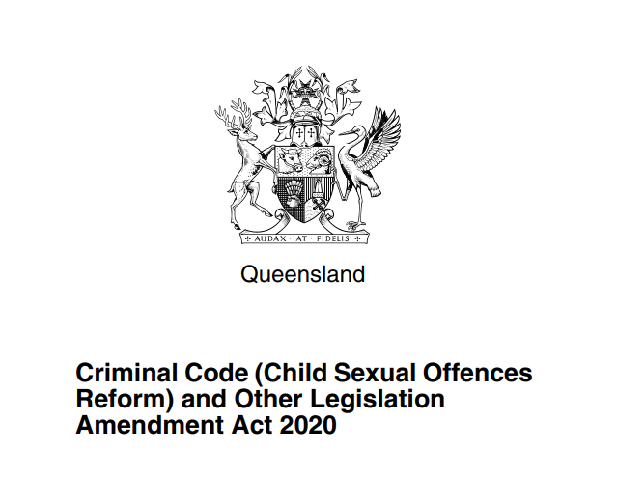
Criminal Code Amendments
Child Sexual Offence
Failure to Report
Failure to Protect
Notes:
New Queensland Laws commenced 5 July 2021 Failure to Report Offence: all adults must report sexual offending against children to the police unless they have a reasonable excuse (i.e. the offence has already been reported). Failure to Protect Offence: adults in an institutional setting (e.g. a school, church or sporting club) must protect children from the risk of a sexual offence being committed against them. The law attaches a criminal penalty to wilful or negligent failures to do so.

Slide 44
Child Sexual Offence (Criminal Code)
means an offence of a sexual nature committed in relation to a child (defined as under 16yrs), by an adult (defined as 18yrs or older) including, for example (but not limited to):
Grooming a child
Distributing intimate images of a child
Carnal knowledge with a child under 16yrs old
Using the internet to procure a child under 16 yrs old

Slide 45
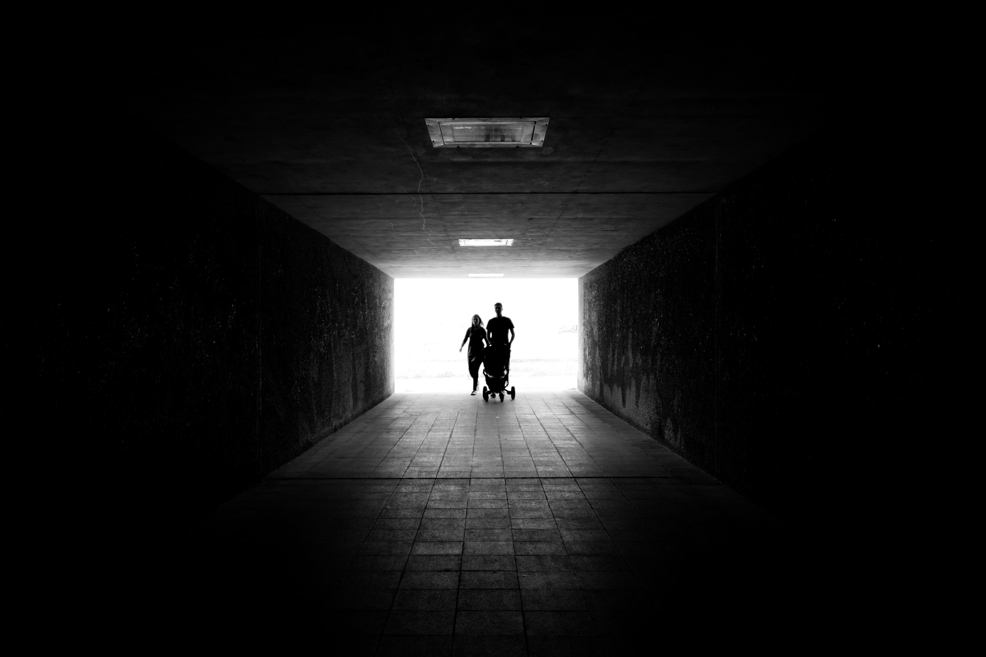
What is Grooming?
The deliberate process of building a trust relationship to create opportunities for abuse to take place

Slide 46
Failure to Report Offence
If an adult in the institution fails to report to police:
Reasonable suspicion of child sexual offence (or ought to reasonably suspect) and
the child is under the care of the institution (including school) at the time and
the offence is committed by another adult who is associated with the institution.
(unless they have a reasonable excuse i.e. the offence has already been reported).
Penalty: 3 years imprisonment
Notes:
If you gain information after 5 July 2021 that leads you to reasonably believe a sexual offence has been committed against a child you must report it even if it happened a long time ago.
So, if the victim is now an adult (but was a child when the offence happened) you will still have to report the offence to police.
However, if you reasonably believe they do not want to reveal the information to police, then you do not need to report it.

Slide 47
Failure to Protect Offence
An accountable person (an adult who is associated with an institution, other than a regulated volunteer) will be liable where they:
Know there is significant risk that another adult associated with the institution will commit a child sexual offence; and
they have the power or responsibility to reduce or remove the risk and
they wilfully or negligently fail to reduce or remove the risk
Penalty: 3 years imprisonment
Notes:
For this offence, an institution means an entity other than an individual that either:
Provides services to children or Operates a facility which may include:
schools
Religious organisations
Child-care-centres
Youth organisations
An adult will be associated with the institution if:
They own it or are involved in its management
Are employed by the institution
Volunteer for the institution
Engage in an activity with the institution that requires a Blue Card

Slide 48
Privacy Act 1988 (Cth)
Personal information is protected under the Commonwealth Privacy Act.
Exceptions:
Informed consent given by an individual
Enforcement activities e.g. Police investigation
Serious threat to safety of others
Act on unlawful activity or serious misconduct

Slide 49
Who can you notify?
Queensland Police | 131 444 (PoliceLink) policelink@police.qld.gov.au | Child Safety Services | Regional Intake Service 1300684062 1800 177 135 (after hours)
Professional Standards and Safeguarding Office CAIRNS | 0740509765 safeguarding@cns.catholic.edu.au | STOPline | 1300 304 550 doc@stopline.com.au
Queensland Professional Standards Office | 1800 337 928 psoqld@catholic.net.au | Office of the Public Guardian | 1300 653 187 adult@publicguardian.qld.gov.au
Call ‘000’ in an emergency or where a person is in immediate danger/risk.
Notes:
There are multiple Diocesan and external contacts that you can make a referral to.
The safety of others must be the first priority in all situations which raise potential abuse or safeguarding risks.
The Diocese also encourages diocesan personnel, parishioners and the community to utilize the STOPline Service which is an independent commercial service funded by the diocese to receive confidential disclosures and information.

Slide 50
Mandatory Reporters – Child Abuse/Neglect
Qld legislation outlines a range of roles and jobs that by law must report any suspected child abuse or neglect.
Child Protection Act 1999 (Qld)
teachers
doctors
registered nurses
police officers
a person performing a child advocate function under the Public Guardian Act 2014
early childhood education and care professionals
Education (General Provisions) Act 2006 (Qld) – Reporting Sexual Abuse
All staff members (i.e.: not only teachers)
School Board & Principals must report to police
Notes:
The Diocese of Cairns has implemented a Whistleblower policy to encourage the reporting of suspected serious misconduct or any other serious wrongdoing by those connected with the diocese.

Slide 51
Key Message
Safeguarding is everyone’s responsibility.

Slide 52
Professional Standards & Safeguarding Office
P: 07 40509765 E: safeguarding@cns.catholic.edu.au
U3/220-226 McLeod Street (level 1); Cairns North
PO Box 5296, Cairns Qld 4870

